Slide 1
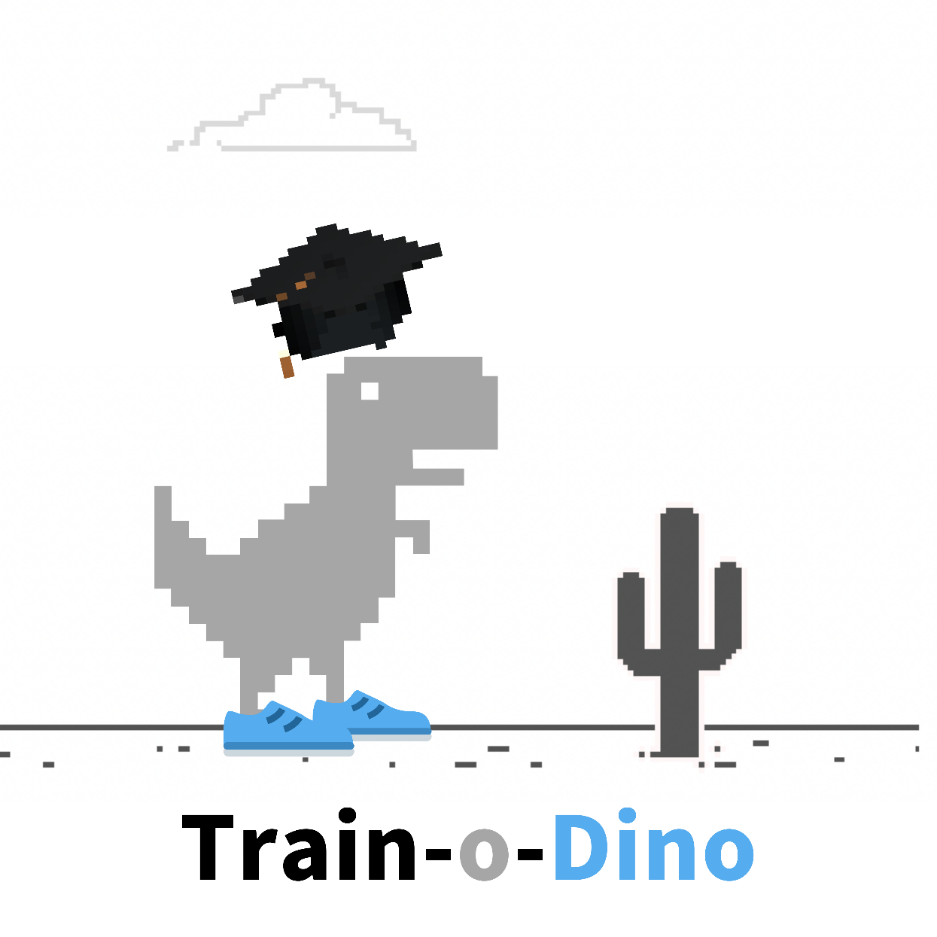
Project Presentation
Arunpriya Gobinath || 100841238
Jugnu Shefin || 100814025
Ramasubramanian Dharumaperumal || 100810343
Raj Dholakia || 100813041
Sourabh Potdar || 100844478
Product Manager: Marcos Bittencourt

Slide 2
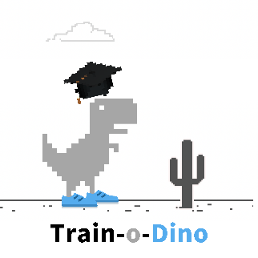
Table of Contents
Problem Description
Project demo
Technologies
Challenges
Project scope and evaluation
Solution Description

Slide 3
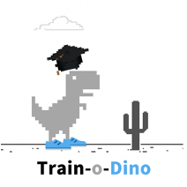
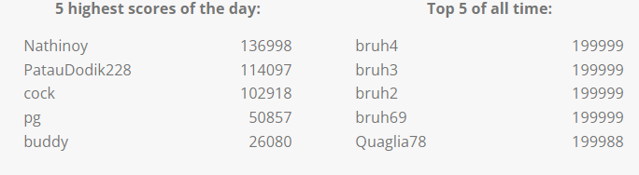
Problem Description
What is the Dino Run game?
When our internet connection goes down and we feel like a Neanderthal, Google understands our plight and provides some fun entertainment to pass the time while our connection to the World Wide Web is resurrecting Chrome dinosaur offline game!
It is a primitive endless runner game in the Chrome browser. The protagonist is a charming little T-Rex dinosaur who is running through an ancient desert.
What is the goal of the Game?
Of course, the dinosaur game has its purpose: to avoid cacti and pterodactyls. Though the game seems easy, it does not take long to get hard because the game’s speed will be constantly increasing as our progress further
How to play the game?
On both desktop and mobile, the game may be played in the Chrome browser. The control is the simplest: When the black dinosaur appears in our browser, suggesting that there is no Internet connection, we just hit the spacebar to begin the game. Jumping over obstacles is also done with the spacebar. To duck, use the down arrow. If we're on a mobile device, simply tapping the little Chrome Dino will activate it and help it avoid obstacles.
Why should we train this Dino?
If we are trying to create AI, why not try to see how these algorithms perform at playing games? Games can be learnt from scratch – with usually a simple goal (of survival in this case).
Training a virtual agent to outperform human players can teach us how to optimize different processes in a variety of different and exciting subfields. By better understanding different aspects of intelligence, we can use this knowledge as inspiration to build novel computer systems that learn to find solutions to difficult problems on their own.
What are the high scores like?
Source : (https://chromedino.com/)

Slide 4
Solution Description
Use of Reinforcement Algorithm
We will create a base model using multiple online resources.
Algorithm
The algorithm would describe a high-level overview of the steps to be undertaken.
Achieve the live position of the Dino in the game.
Preparing the data to be fed into the Machine Learning model.
Q-Learning Reinforcement learning algorithm is to be used.
The way the model is going to be trained.
Cloud Services
Two ways to use cloud computing for the project.
Training and testing the performance of the model on the cloud – there might be a cost associated.
Create a website, a playground for hyperparameter tuning for the model.

Slide 5
Project Scope
The main goal is to develop an algorithm that scores more than 10000+ (highest category on the website) on the Dino Game.
In-scope deliverables
Prepare a plan to acquire, clean and prepare the current state of the game for the model input.
Train and test a reinforcement learning (Q-Learning) algorithm to play the game and make the highest score variable.
Improve the performance of the model by tuning the hyperparameters and using different network architectures.
Out-of-scope deliverables
Creating a duplicate version of the dino game as a test environment for the training and testing of the reinforcement learning model.
Data collection for model training.

Slide 6





Technologies to be Used
Python
Machine learning libraries : Scikit-learn, TensorFlow, Keras
HTML/CSS/JavaScript for building the browser extension
Selenium
Git and GitHub for code management and version control.

Slide 7
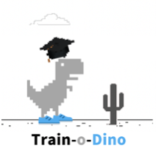
Challenges The most difficult problems faced during implementation
Deployment of the algorithm on a webpage - to allow users to tune the hyperparameters of the model.
Expected features
Ability to navigate through the obstacles and move forward.
Option to select a background color to hide spoilers (only in Hidden Mode).
Project acceptance criteria
Beat the target score of 10000 points.

Slide 8

Thank you!

